Slide 1
Welcome to Level 3 Health, Social Care and Early Years
Year 11 into Year 12 Introductory Pack 2021
Inside this booklet you will find several ideas on things to do to help you get ready for 6th form HSC.
We hope you enjoy them.
The Health and Social Care Team look forward to seeing you in September

Slide 2
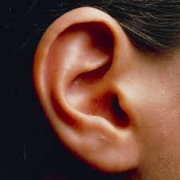
Listen
https://www.bbc.co.uk/sounds/category/factual-healthandwellbeing
BBC Radio has lots of interesting programmes e.g.
All in the Mind
Inside Science
Explore
https://www.open.edu/openlearn/free-courses/full-catalogue
READ
Still Alice
Eleanor Oliphant is Completely Fine
The Fault in Our Stars
This is Going to Hurt
We need to talk about Kevin
Finding Audrey
One Flew Out of the Cuckoo’s Nest
TV
24 hours in A&E
One born every minute
Secret Life of 4 year olds
The Updateables
Panorama or Dispatches
Call the Midwife
999: On the Front Line
Doc Martin
Write
A letter to an elderly neighbour to see if they are OK
A letter to a child who’s afraid to go to school
A leaflet with ideas to promote exercise and healthy eating in 6th form
A booklet which shows someone how to reduce stress
Let’s Get Ready for
Level 3
Health, Social Care and Early Childhood
Film
The Fault in Our Stars
My Sister’s Keeper
Still Alice
The Kings Speech
Little Miss Sunshine
Girl, Interrupted
28 Days
The Breakfast Club
Create
Devise a game about one aspect of health, social care or early childhood that you are interested in
Make a recording to help someone sleep or help with anxiety
Create a ‘news video’ to describe something about Covid 19
Research
https://www.nhs.uk/conditions/social-care-and-support-guide/
https://www.prospects.ac.uk/job-profiles/browse-sector
https://www.nice.org.uk/
https://www.who.int/

Slide 3
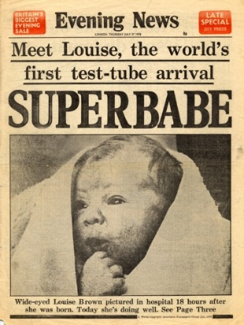
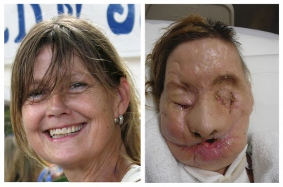
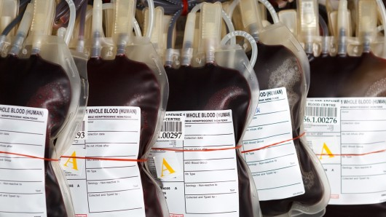
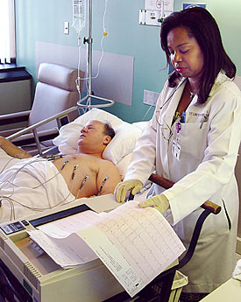
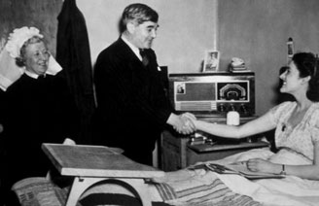
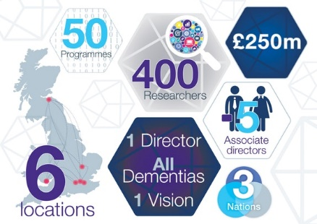
Advances in Health & Social Care…
First put these advances in a time line…
Try to do it without googling or looking up the answers first
UK legislation makes smoking illegal in public buildings
First full face transplant
Campaign Heads Together launched
First IVF baby born in UK
Synthetic blood first made
NHS born!
Penicillin discovered in London
First
electrocardiogram
Next - look up the dates and see how near you were to the correct timeline!
Change 4 Life campaign started
First stethoscope invented
First bionic hand fitted in UK
The Dementia Institute formed in UK

Slide 4
https://rcni.com/hosted-content/rcn/first-steps/why-communication-important
Read, watch and listen to each page as it helps you understand why communication is important in health and social care
Page 24 – 30
https://www.scie.org.uk/safeguarding/adults/introduction/types-and-indicators-of-abuse
Not an easy topic to read about, but this is another fundamental everyone has to know.
https://www.equalityhumanrights.com/en/human-rights/what-are-human-rights
Read the sections and look at the videos
Once you’ve finished then look at the section on The Human Rights Act
https://www.equalityhumanrights.com/en/equality-act-2010/what-equality-act
Read all about The Equality Act
https://www.scie.org.uk/personalisation/introduction/what-is
A short video introducing personalization in HSC
https://www.hee.nhs.uk/about/our-values
The NHS values – click on each one to see more information
There are many core elements to studying Health and Social Care.
Communication and how it’s used in caring for people
How the law protects us
The values of care we use
Person centred care
In the box are some links to reading materials or videos that will help you build an understanding of these topics.
Then when you arrive in 6th form you’ll be aware of some of the important aspects – especially if you’ve never studied the subject before

Slide 5
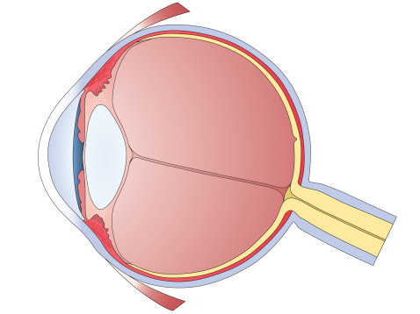
Glaucoma
Nephrotic Syndrome
Irritable Bowel Syndrome
Emphysema
Small intestine
Kidneys
Lungs
Cirrhosis
Stroke
heart
Coeliac Disease
Angina
Start Here
Liver
Find out about TWO of the conditions – describe how they effect a person
Colon
Match the body organ to the condition that affects it.
Eye
Do you know anyone with asthma or another long term condition? Talk to them and write a case study to show how they were diagnosed, how it effects their life and what treatment and monitoring they require.
Brain
Investigate and explain how a doctor would diagnose and treat THREE of the conditions
Health

Slide 6
Think about how the COVID 19 pandemic has changed our lives.
Investigate our area and find out about the different community schemes who are supporting others who are elderly or vulnerable because of their health.
Draw a map of our area and put on the groups and schemes you have found.
Describe an example of a community group that has helped others.
Explain how you think this event will change how we live our lives and care for the vulnerable in our society.
Write a letter to a resident in a local care home - or draw a picture – and send it to the care home nearest to where you live.
Click on the picture or use the link:
https://www.scie.org.uk/children/looked-after-children/care-leavers/care-leavers-webinar
Go to time 22.45 to hear all about an East Anglian base charity – it’s a pilot scheme. Once you’ve listened – write down a short summary of how this project works.
Home share is a fairly new idea in the UK. It is where (usually) an older person offers cheaper accommodation to a (usually) younger person in exchange for support in their home.
Explain what you think about this scheme.
Would you take part? Explain your feelings.
Research other countries where this has worked really well and write a summary of your findings to share with others in 6th form.
Social Care

Slide 7
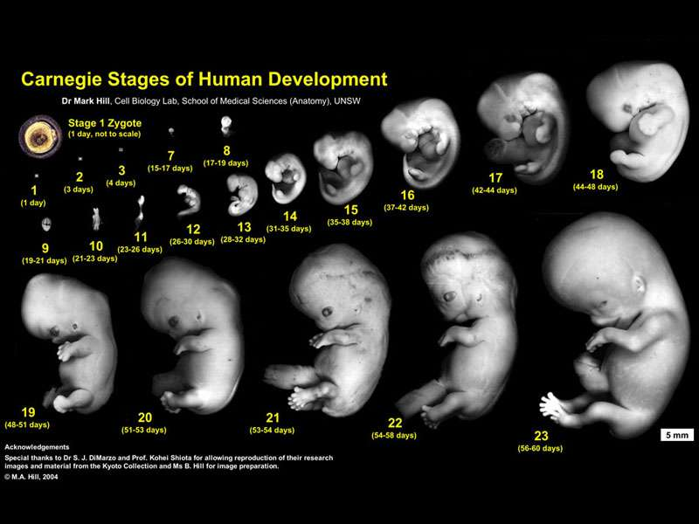
There are nine early childhood values of care. Here are four of them:
Making the welfare of the child paramount
Keeping children sage and maintaining a health environment
Encouraging children’s learning and development
Valuing diversity
Imagine you are the owner of a nursery school. Explain what each one means and how you would apply these in your nursery (how you would use them)
If you know anyone with a child in a nursery ask them how their nursery meets the values of care.
Create an activity that you could play with a child who is 8 years old or younger which would encourage their learning and development.
Click on the picture or use the following link to hear all about Alexandria who is “the same but different”.
https://www.youtube.com/watch?v=jZOAe5eu2FE
Alex has Down’s syndrome.
Find out how this condition occurs.
Write a summary of Alex’s story to show what Alex’s life is like compared to other Year 3 children.
Watch the documentary called
‘Brain Matters’
Click on or use the link below
Children and development
https://www.youtube.com/watch?v=Rw_aVnlp0JY
Why is it that some children thrive while others do not? Is it a matter of genetics, IQ, socioeconomic background or education?
A really interesting film about how a baby’s brain develops.
Pregnancy is divided into three trimesters.
Using pictures describe how the foetus develops during each one.
Which practitioners help the parents to be? Choose two and describe their roles during pregnancy, birth and early years.
Early Childhood

